Slide 1

CV Shortlisting Tool
Presented by-
Masum Rana
ID: 151-35-1029
Dept. of SWE
Supervised By-
Ms. Syeda Sumbul Hossain
Lecturer
Dept. of SWE
DAFFODIL INTERNATION UNIVERSITY

Slide 2
Contents
Motivation
Objectives
Software Requirements Specification
Use Case Diagram
Activity Diagram
System Sequence Diagram
Data flow Diagram
Database Design Diagram
Background Study
Tools & Technology
User Interface
1

Slide 3
Motivation
Many Organizations, when recruit an employee for a post they get a lot of CV’s. Among all the submitted CV’s, it takes long time to find out the perfect candidate by checking each CV’s one by one. To reduce the problem the system will help them to shortlist the CV’s without go through all of them.
2

Slide 4
Objectives
Make a short list of CV’s and find the appropriate candidate for a particular job post without go through all the submitted CV’s.
3

Slide 5
Software Requirements Specification
SRS ID | SRS Name | Description | F/N | Priority
SRS-01 | Add Requirements | Admin/HR need to add job requirements such as skills, experiences etc. | Functional | High
SRS-02 | Add CV’s | Admin/HR will Add CV’s for a particular job post by selecting Job ID | Functional | High
SRS-03 | Analysis CV’s | Admin/HR will command the system to analysis the CV’s | Functional | High
SRS-04 | View Shortlist CV’s | Admin/HR can shortlist and view the analyzed CV’s by Shortlist option | Functional | High
4
Copyright © 2018 Daffodil International University

Slide 6
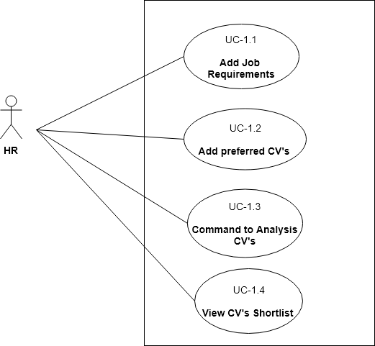
Use Case Diagram
Figure 1.1- Use Case Diagram
5

Slide 7
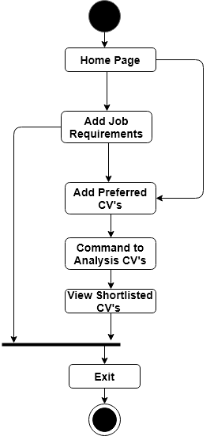
Activity Diagram
6
Figure 1.2- Activity Diagram

Slide 8
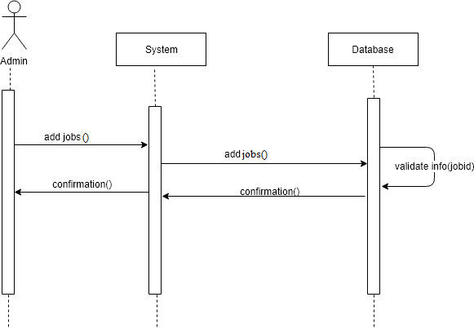
System Sequence Diagram: Add job details
7
Copyright © 2018 Daffodil International University

Slide 9
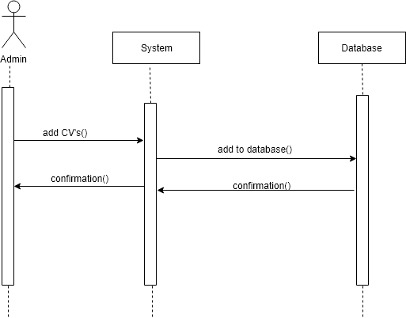
System Sequence Diagram: Add CV
8
Copyright © 2018 Daffodil International University

Slide 10
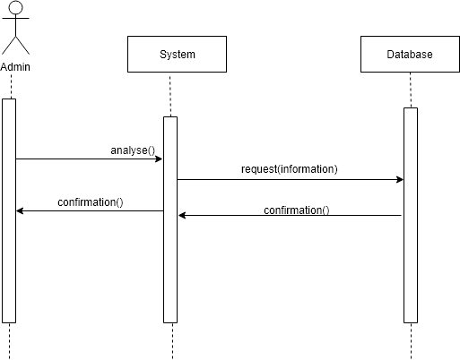
System Sequence Diagram: Command Analyze CV’s
9
Copyright © 2018 Daffodil International University

Slide 11
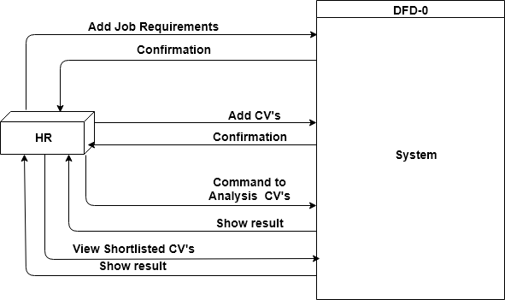
Dataflow Diagram(Level-0)
Figure 1.6- Dataflow Diagram(L-0)
10

Slide 12
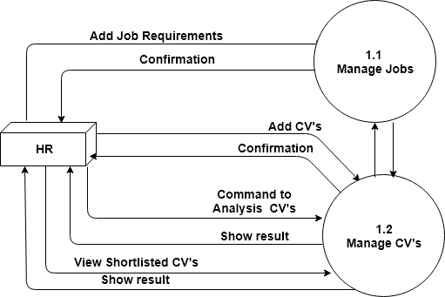
Dataflow Diagram(Level-1)
Figure 1.7: Dataflow Diagram(L-1)
11

Slide 13
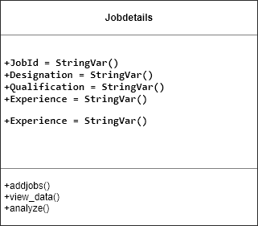
Class Diagram
12
Copyright © 2018 Daffodil International University

Slide 14
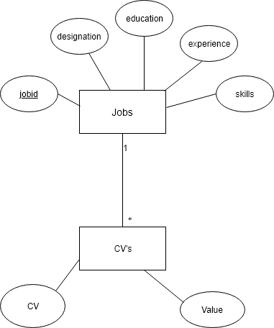
Database Design Diagram
13
Copyright © 2018 Daffodil International University

Slide 15
Background Study
Vector Space Model
Document indexing where content bearing terms are extracted from the document text.
The weighting of the indexed terms to enhance retrieval of document relevant to the user.
Ranks the document with respect to the query according to a similarity measure.
Vector space model or term vector model is an algebraic model for representing text documents (and any objects, in general) as vectors of identifiers, such as, for example, index terms. It is used in information filtering, information retrieval, indexing and relevancy rankings.
14

Slide 16
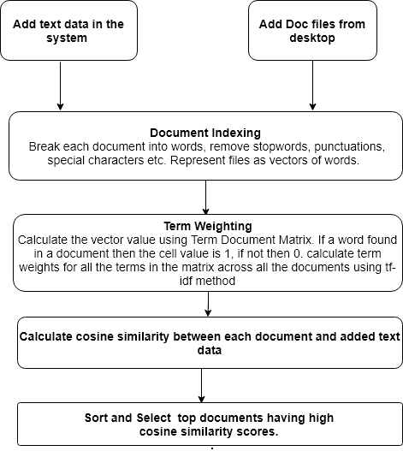
Workflow of Vector Space Model
15
Copyright © 2018 Daffodil International University

Slide 17
Tools & Technology
Python 3.7
SQLite 3
Tkinter
16

Slide 18
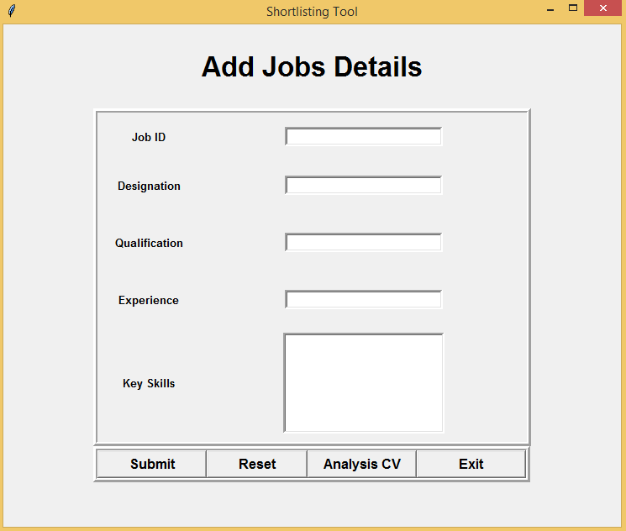
User Interface
17
Copyright © 2018 Daffodil International University

Slide 19
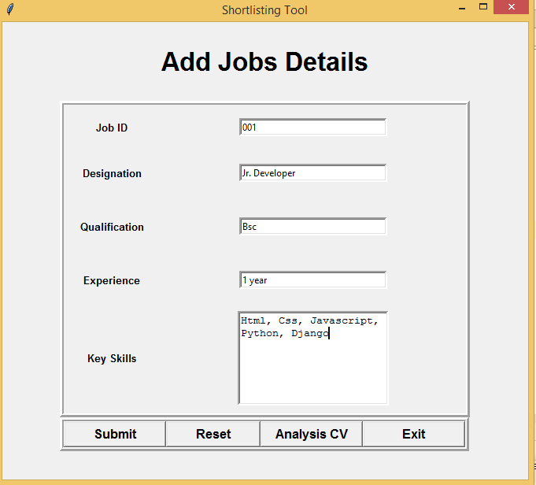
User Interface (Cont.)
18
Copyright © 2018 Daffodil International University

Slide 20
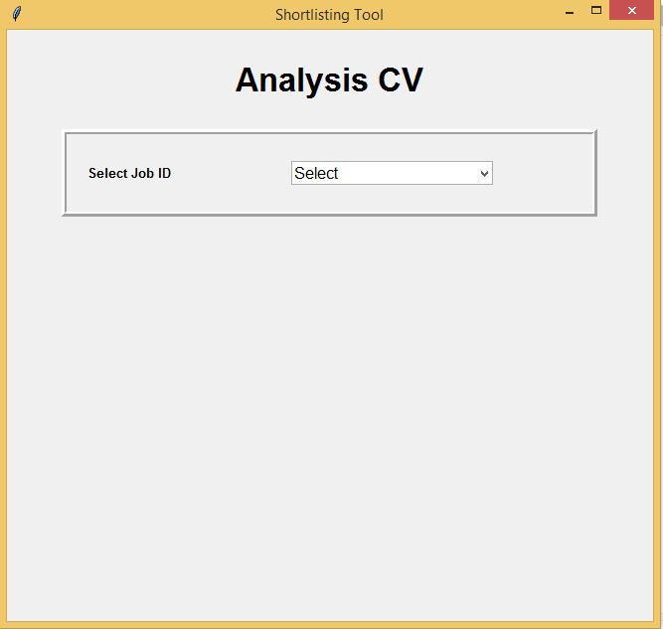
User Interface (Cont.)
19
Copyright © 2018 Daffodil International University

Slide 21
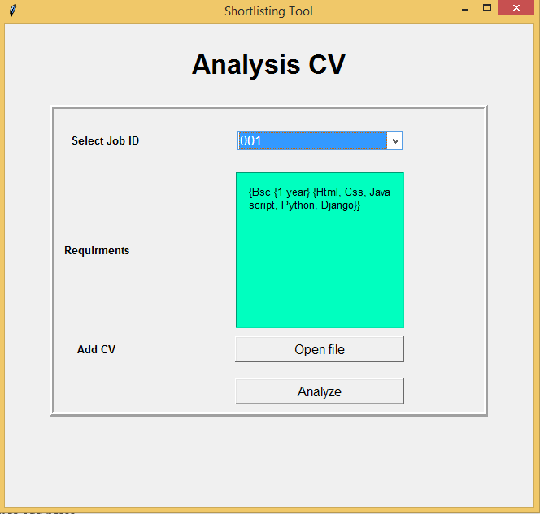
User Interface (Cont.)
20
Copyright © 2018 Daffodil International University

Slide 22
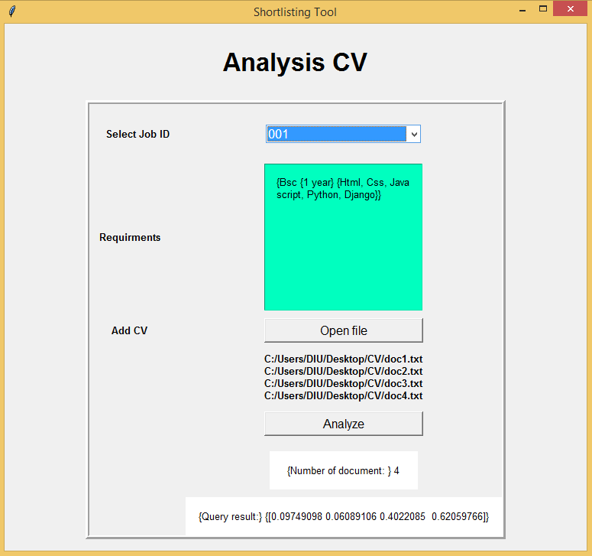
User Interface (Cont.)
21
Copyright © 2018 Daffodil International University

Slide 23
Github Link
https://github.com/masumr1029/Project
22
Copyright © 2018 Daffodil International University

Slide 24
THANKS!
23

